Slide 1
Day 10
Chapters 12 Advanced File Operations Chapter 13 Introduction to Classes

Slide 2
1. Requires fstream header file
Using Files
use ifstream data type for input files
use ofstream data type for output files
use fstream data type for both input, output files
Can use >>, << to read from, write to a file
Can use eof member function to test for end of input file

Slide 3
fstream Object
fstream object can be used for either input or output
Must specify mode on the open statement
Sample modes: ios::in – input ios::out – output
Can be combined on open call:
dFile.open("class.txt", ios::in | ios::out);

Slide 4
fstream Object
fstream memberData;
memberData.open("member.txt", ios::in|ios::out); if(!memberData) {
cout<<"\nNot able to create a file. MAJOR OS ERROR!!
\n";
}
memberData.close();
}

Slide 5
Lets look at reading a file and using the getline function to detect characters
#include <iostream> #include <fstream> #include <string> using namespace std;
int main()
{
string input
fstream dataFile("cs3060_2019.txt", ios::in);
if (dataFile)
{
getline(dataFile, input, '$’);
while (dataFile)
{
cout << input << endl; getline(dataFile, input, '$');
}
dataFile.close();
}
else
{
cout << "ERROR: Cannot open file.\n";
}
return 0;
}

Slide 6
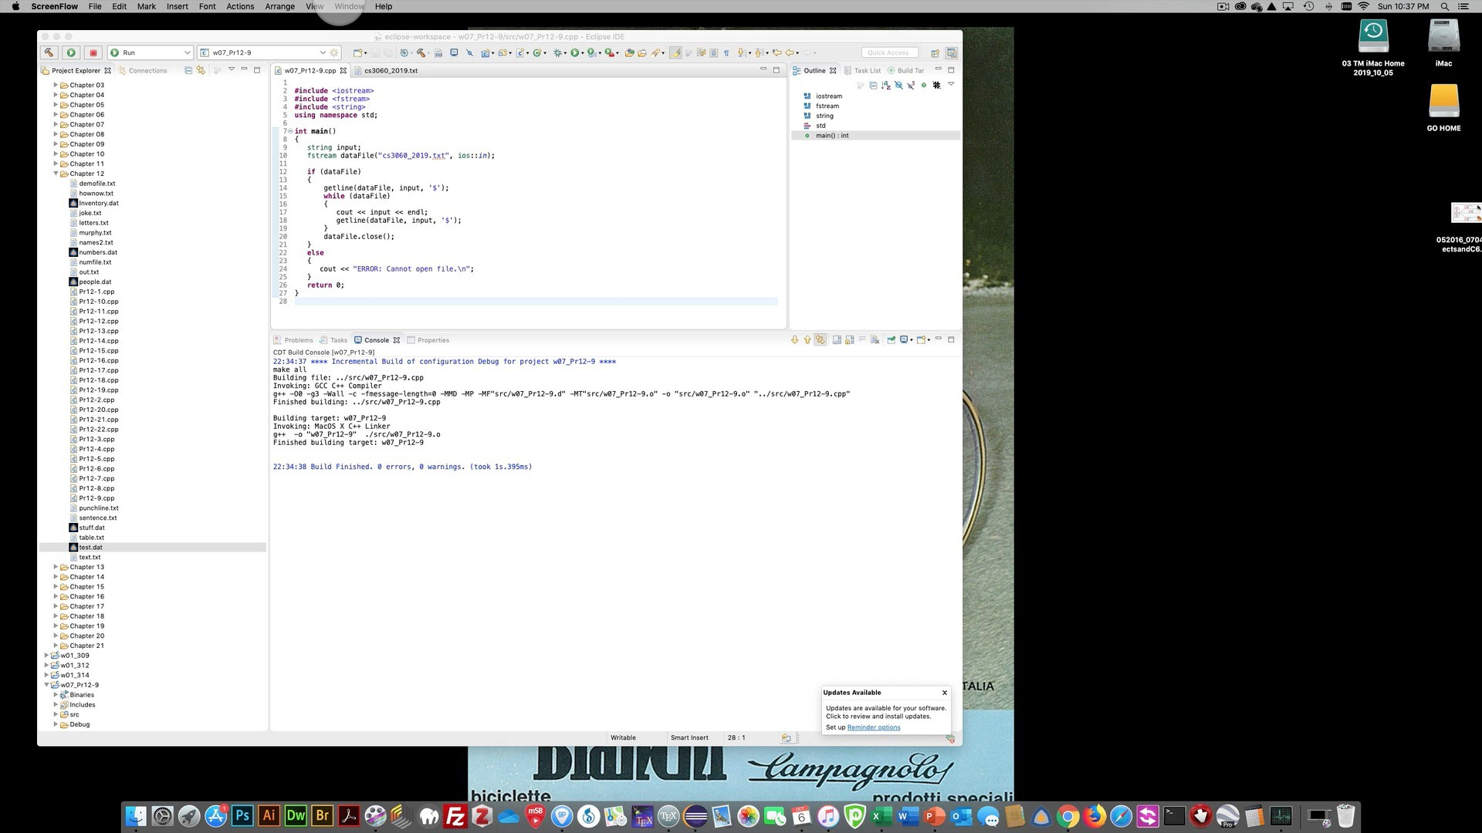
Lets look at reading a file and using the getline function to detect characters

Slide 7
Lets look at reading a filestream objects may be passed by reference to functions
#include <iostream> #include <fstream> #include <string> using namespace std;
bool openFileIn(fstream &, string);
void showContents(fstream &);
int main()
{
fstream dataFile;
if (openFileIn(dataFile, "names2.txt"))
{
cout << "File opened successfully.\n";
cout << "Now reading data from the file.\n\n"; showContents(dataFile);
dataFile.close();
cout << "\nDone.\n";
}
else
cout << "File open error!" << endl;
return 0;
}
bool openFileIn(fstream &file, string name)
{
file.open(name, ios::in);
if (file.fail())
return false; else
return true;
}
void showContents(fstream &file)
{
string line;
while (file >> line)
{
cout << line << endl;
}
}

Slide 8
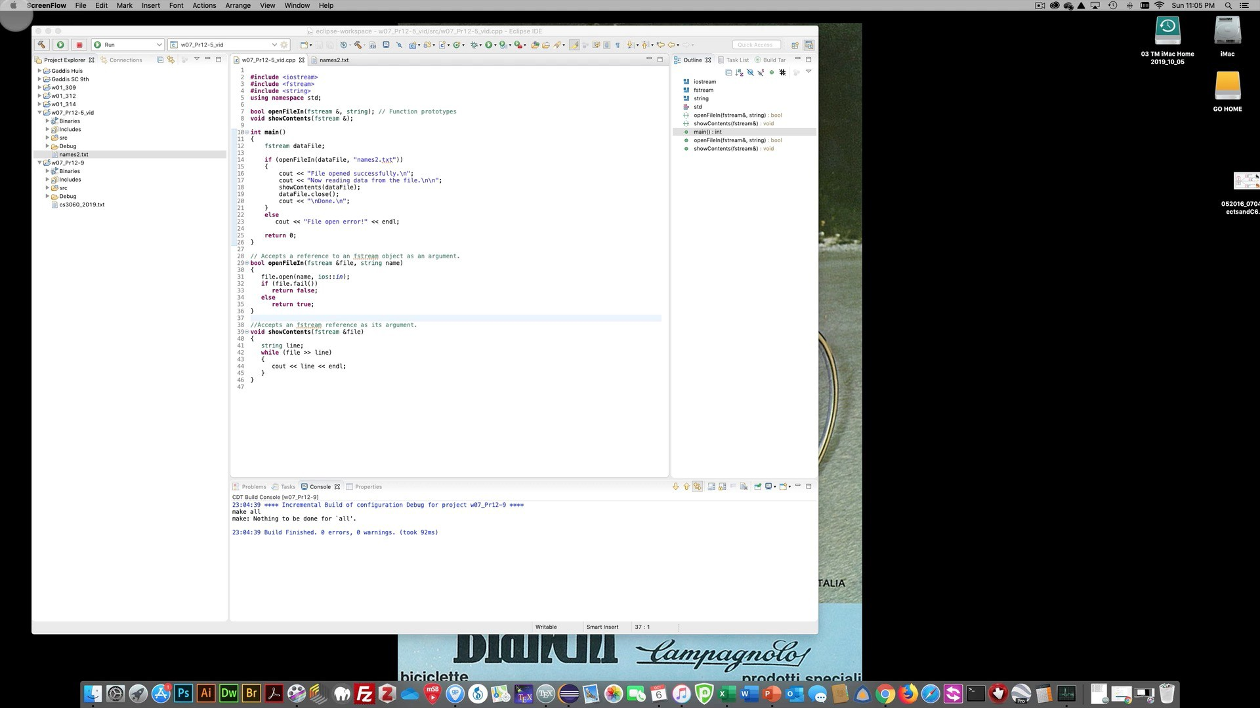

Slide 9
Creating Records with Structures
Can write structures to, read structures from files
To work with structures and files,
use ios::binary file flag upon open
use read, write member functions

Slide 10
Creating Records with Structures
const int SIZE = 12;
struct Division
{
char divName[SIZE];
int quarter;
double sales;
};
int main()
{
fstream file("corp.dat", ios::out | ios::binary); Division east, west, north, south;
int qtr;
strcpy_s(east.divName, "East");
cout << "Enter the quarterly sales for the **** Divison:\n";
for (qtr = 1; qtr <= 4; qtr++)
{
east.quarter = qtr;
cout << "\tQuarter " << qtr << ": "; cin >> east.sales;
file.write(reinterpret_cast<char *>(&east), sizeof(east));
}

Slide 11
Creating Records with Structures
struct TestScore
{
int studentId; double score; char grade;
};
TestScore oneTest;
...
// write out oneTest to a file gradeFile.write(reinterpret_cast<char *> (&oneTest), sizeof(oneTest));

Slide 12

Week 07
Chapter 13 Introduction to Classes

Slide 13
Lets first review structs and classes for a minute

Slide 14



Records (structs) (1 of 3)
A compound statement consists of zero or more statements enclosed in curly braces ({ }).
class X
{
public:
// stuff foo ...
};
struct X
{
// stuff foo ...
};
SYNTAX
{ [ statement-list ] }
if( MidTermScore_CS3060 > 100 )
{
cout << ”You’re a rockstar no need to take CS3060 final\n";
Alert();
}
else
Grade -= MidTermScore_CS3060 ;

Slide 15
Records (structs) (2 of 3)
A struct is a
definition, not a declaration
Must declare a variable of that type to use it
struct houseType
{
//stuff about the foo house
};
//variable declaration houseType newHouse;

Slide 16

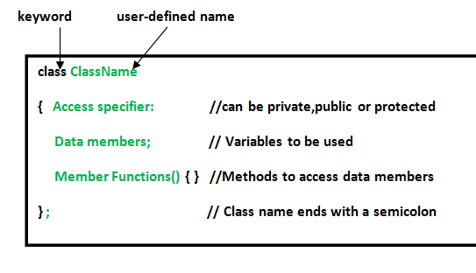
Rory’s Accessing Class Members: DAMN MONKEYS
#include <bits/stdc++.h> using namespace std; class Monkey{
public:
string monkeyname;
void printname()
{
// Access specifier
// Data Members
// Member Functions()
cout << ”Monkeyname is: " << monkeyname;
}
};
int main()
{
Monkey obj1;
// Declare an object of class geeks
obj1.monkeyname = ”vervet"; obj1.printname(); | // // | Accessing Data member Accessing Member function
return 0;
} OUTPUT IS. vervet

Slide 17
Rory’s Accessing Class Members: DAMN MONKEYS
#include <bits/stdc++.h>
using namespace std;
class
Monkey{
public:
string monkeyname;
// Access specifier
// Data Members
void printname() // Member Functions()
{ cout << ”Monkeyname is: " <<
monkeyname;
}
};
int main()
{
Monkey
obj1; // Declare an object of
class
geeks
obj1.
monkeyname = ”vervet"; // Accessing Data member
obj1.printname();
return 0;
}
// Accessing Member function

Slide 18
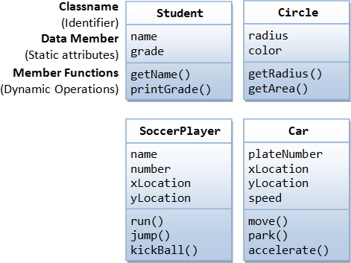
Procedural and Object-Oriented Programming
Procedural programming focuses on the process/actions that occur in a program
Object-Oriented programming is based on the data and the functions that operate on it. Objects are instances of ADTs that represent the data and its functions

Slide 19
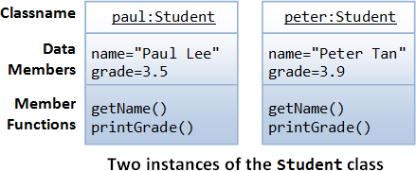
Limitations of
Procedural
Programming
If the data structures change, many functions must also be changed
Programs that are based on complex function hierarchies are:
difficult to understand and maintain
difficult to modify and extend
easy to break

Slide 20
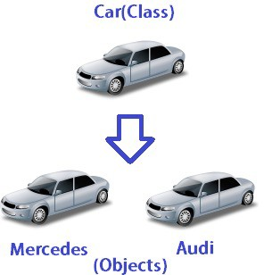
Classes and Objects

Slide 21
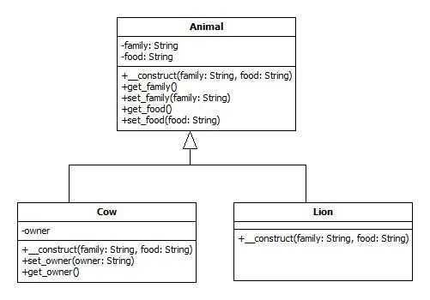

Object-Oriented Programming Terminology
class: variables and functions in the class can have different properties than in a struct
object: an instance of a class, in the same way that a variable can be an instance of a struct

Slide 22
Object-Oriented Programming Terminology
attributes: members of a class
methods or behaviors: member functions of a class
data hiding: restricting access to certain members of an object
public interface: members of an object that are available outside of the object. This allows the object to provide access to some data and functions without sharing its internal details and design, and provides some protection from data corruption

Slide 23
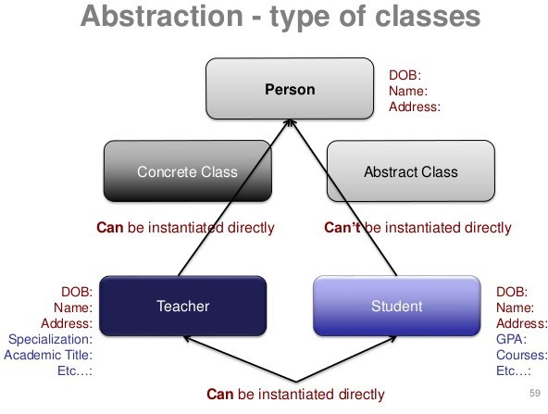
Classes and Objects

Slide 24
Introduction to Classes
Objects are created from a class
Format:
class ClassName
{
declaration; declaration;
};

Slide 25
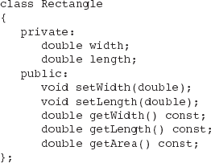
Class Example

Slide 26
Class Example

Slide 27
Class Example

Slide 28
Access Specifiers
Used to control access to members of the class
public: can be accessed by functions outside of the class
private: can only be called by or accessed by functions that are members of the class

Slide 29
Class Example
Private Members
Public Members

Slide 30
More on Access Specifiers
Can be listed in any order in a class
Can appear multiple times in a class
If not specified, the default is private

Slide 31
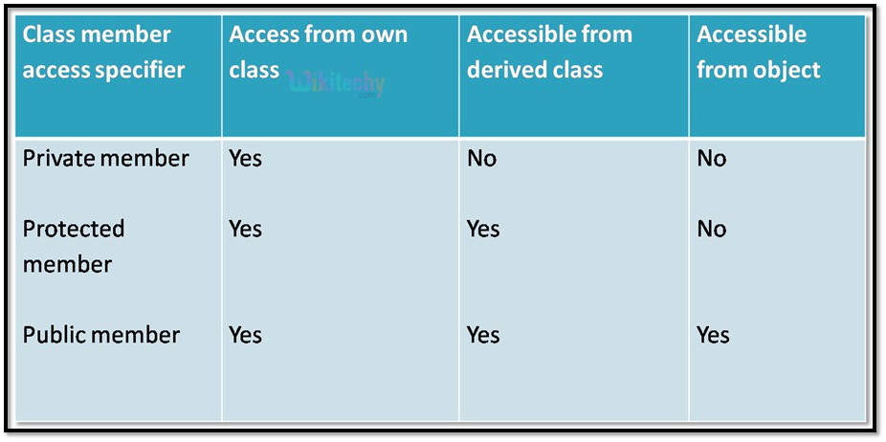
More on Access Specifiers

Slide 32
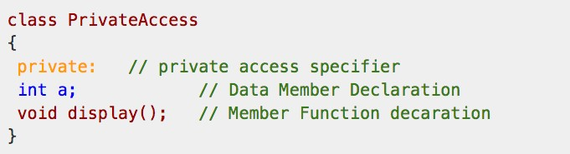
Access control specifier private

Slide 33
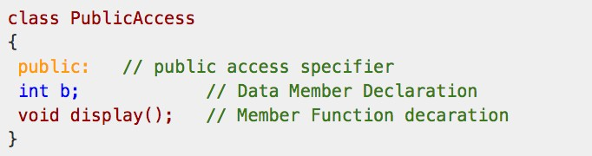
Access control specifier public

Slide 34

Using const With Member Functions
const appearing after the parentheses in a member function declaration specifies that the function will not change any data in the calling object.

Slide 35
Using const With Member Functions

Slide 36
Defining a Member Function
When defining a member function:
Put prototype in class declaration
Define function using class name and scope resolution operator (::)
int Rectangle::setWidth(double w)
{
width = w;
}

Slide 37
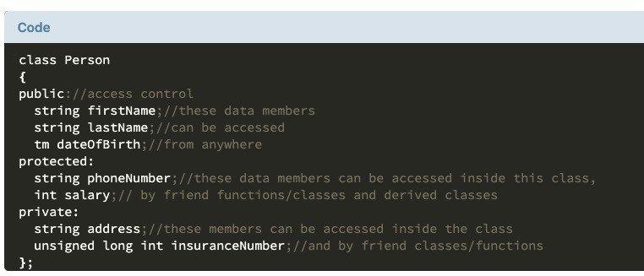
Accessors and Mutators
Mutator: a member function that stores a value in a private member variable, or changes its value in some way
Accessor: function that retrieves a value from a private member variable. Accessors do not change an object's data, so they should be marked const.

Slide 38
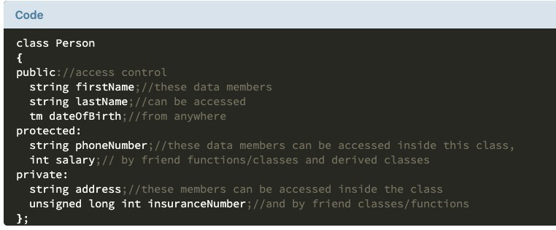
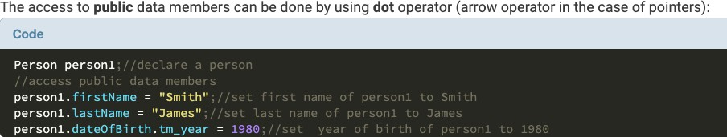
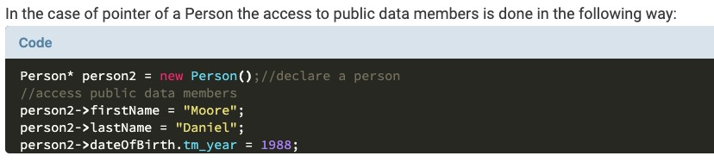
Accessors and Mutators

Slide 39
13.3
Defining an Instance of a Class

Slide 40
Rory’s Accessing Class Members: DAMN MONKEYS
#include <bits/stdc++.h> using namespace std; class Monkey{
public:
string monkeyname;
void printname()
{
// Access specifier
// Data Members
// Member Functions()
cout << ”Monkeyname is: " << monkeyname;
}
};
int main()
{
Monkey obj1;
// Declare an object of class geeks
obj1.monkeyname = ”vervet"; obj1.printname(); | // // | Accessing Data member Accessing Member function
return 0;
} OUTPUT IS. vervet

Slide 41
Rory’s Accessing Class Members: DAMN MONKEYS
#include <bits/stdc++.h>
using namespace std;
class
Monkey{
public:
string monkeyname;
// Access specifier
// Data Members
void printname() // Member Functions()
{ cout << ”Monkeyname is: " <<
monkeyname;
}
};
int main()
{
Monkey
obj1; // Declare an object of
class
geeks
obj1.
monkeyname = ”vervet"; // Accessing Data member
obj1.printname();
return 0;
}
// Accessing Member function

Slide 42
Defining an Instance of a Class
An object is an instance of a class
Defined like structure variables:
Rectangle r;
Access members using dot operator:
r.setWidth(5.2); cout << r.getWidth();
Compiler error if attempt to access private member using dot operator

Slide 43
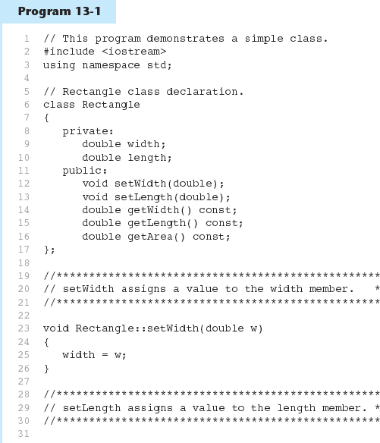

Slide 44
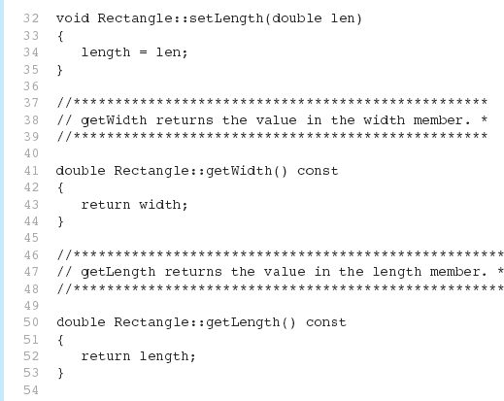
Program 13-1 (Continued)

Slide 45
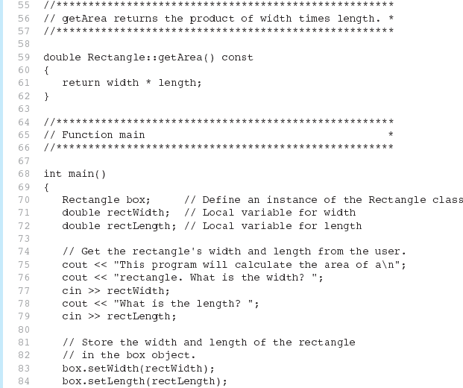
Program 13-1 (Continued)

Slide 46
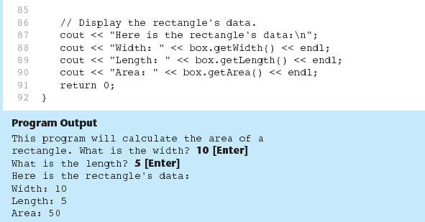
Program 13-1 (Continued)

Slide 47
Avoiding Stale Data
Some data is the result of a calculation.
In the Rectangle class the area of a rectangle is calculated.
length x width
If we were to use an area variable here in the Rectangle class, its value woul dependent on the length and the width.
If we change length or width without updating area, then area would beco
stale.
To avoid stale data, it is best to calculate the value of that data within a member f rather than store it in a variable.

Slide 48
Pointer to an Object
Can define a pointer to an object:
Rectangle *rPtr = nullptr;
Can access public members via pointer:
rPtr = &otherRectangle; rPtr->setLength(12.5);
cout << rPtr->getLength() << endl;

Slide 49
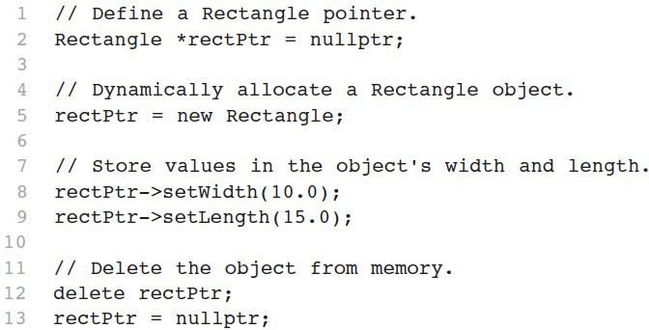
Dynamically Allocating an Object
We can also use a pointer to dynamically allocate an object.

Slide 50
13.4
Why Have Private Members?

Slide 51
Why Have Private Members?
Making data members private provides data protection
Data can be accessed only through public functions
Public functions define the class’s public interface

Slide 52
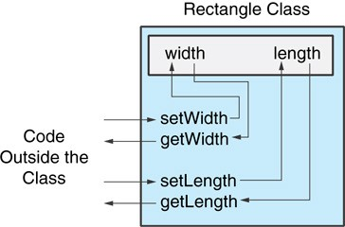
Code outside the class must use the class's public member functions to interact with the object.

Slide 53
13.5
Separating Specification from Implementation

Slide 54
Separating Specification from Implementation
Place class declaration in a header file that serves as the class specification file. Name the file ClassName.h, for example, Rectangle.h
Place member function definitions in ClassName.cpp, for example,
Rectangle.cpp File should #include the class specification file
Programs that use the class must #include the class specification file, and be compiled and linked with the member function definitions

Slide 55
13.6
Inline Member Functions

Slide 56
Inline Member Functions
Member functions can be defined
inline: in class declaration
after the class declaration
Inline appropriate for short function bodies:
int getWidth() const
{ return width; }

Slide 57
Rectangle Class with Inline Member Functions
// Specification file for the Rectangle class
// This version uses some inline member functions.
#ifndef RECTANGLE_H
#define RECTANGLE_H 5
6 | class Rectangle
7 | {
8 | private:
9 | double width;
10 | double length;
11 | public:
12 | void setWidth(double);
13 | void setLength(double);
14
15 | double getWidth() const
16 | { return width; }
17
18 | double getLength() const
19 | { return length; }
20
21 | double getArea() const
22 | { return width * length; | }
23 | };
24 | #endif

Slide 58
Tradeoffs – Inline vs. Regular Member Functions
Regular functions – when called, compiler stores return address of call, allocates memory for local variables, etc.
Code for an inline function is copied into program in place of call – larger executable program, but no function call overhead, hence faster execution

Slide 59
13.7
Constructors

Slide 60
Constructors
Member function that is automatically called when an object is created
Purpose is to construct an object
Constructor function name is class name
Has no return type

Slide 61
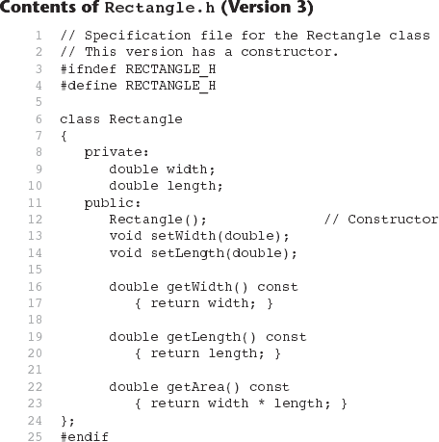

Slide 62
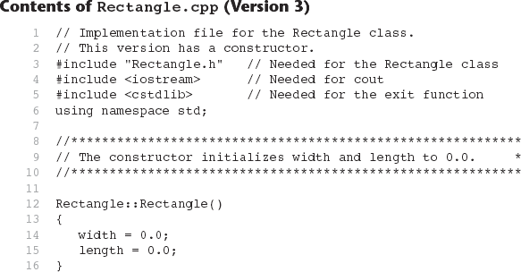
Continues...

Slide 63
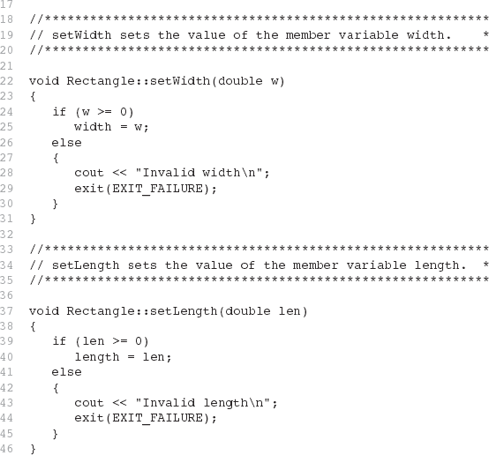
Contents of Rectangle.ccp Version3
(continued)

Slide 64
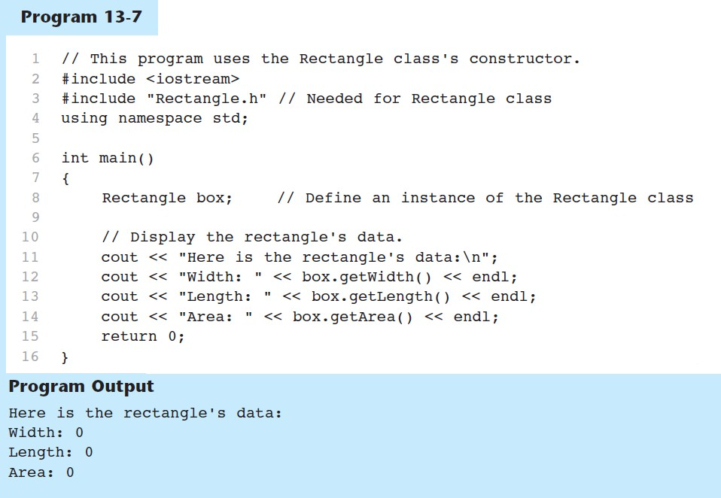

Slide 65
Default Constructors
A default constructor is a constructor that takes no arguments.
If you write a class with no constructor at all, C++ will write a default constructor one that does nothing.
A simple instantiation of a class (with no arguments) calls the default constructor
Rectangle r;

Slide 66
13.8
Passing Arguments to Constructors

Slide 67
Passing Arguments to Constructors
To create a constructor that takes arguments:
indicate parameters in prototype:
Rectangle(double, double);
Use parameters in the definition:
Rectangle::Rectangle(double w, double len)
{
width = w; length = len;
}

Slide 68
Passing Arguments to Constructors
You can pass arguments to the constructor when you create an object:
Rectangle r(10, 5);

Slide 69
More About Default Constructors
If all of a constructor's parameters have default arguments, then it is default constructor. For example:
Rectangle(double = 0, double = 0);
Creating an object and passing no arguments will cause this construct execute:
Rectangle r;

Slide 70
Classes with No Default Constructor
When all of a class's constructors require arguments, then the class has NO default constructor.
When this is the case, you must pass the required arguments to the constructor when creating an object.

Slide 71
13.9
Destructors

Slide 72
Destructors
Member function automatically called when an object is destroyed
Destructor name is ~classname, e.g., ~Rectangle
Has no return type; takes no arguments
Only one destructor per class, i.e., it cannot be overloaded
If constructor allocates dynamic memory, destructor should release it

Slide 73
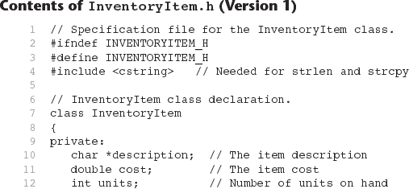

Slide 74
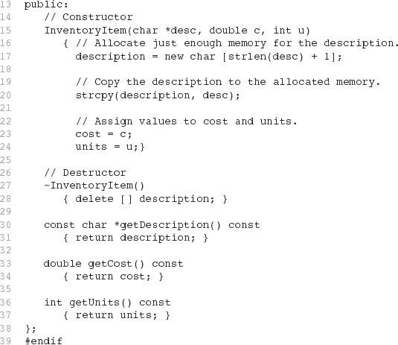
Contents of InventoryItem.h Version1
(continued)

Slide 75
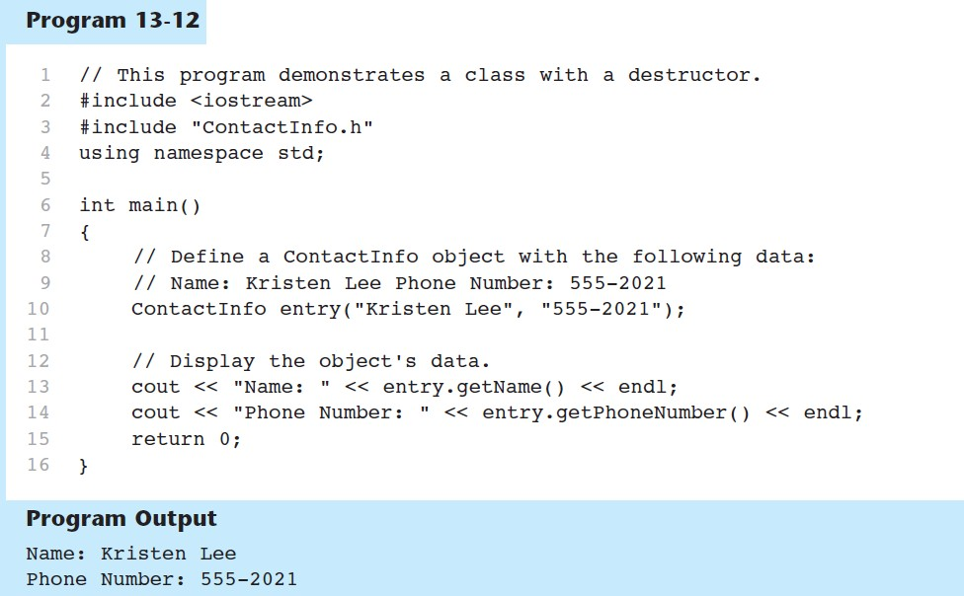

Slide 76
Constructors, Destructors, and Dynamically Allocated Objects
When an object is dynamically allocated with the new operator, its constructor executes:
Rectangle *r = new Rectangle(10, 20);
When the object is destroyed, its destructor executes:
delete r;

Slide 77
13.10
Overloading Constructors

Slide 78
Overloading Constructors
A class can have more than one constructor
Overloaded constructors in a class must have different parameter lists
Rectangle(); Rectangle(double); Rectangle(double, double);

Slide 79
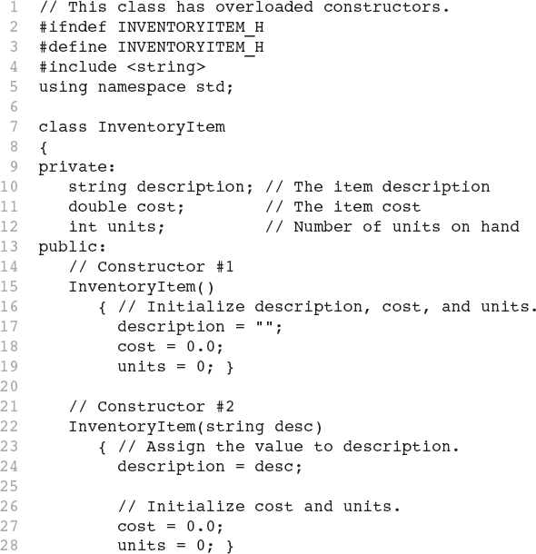
Continues...

Slide 80
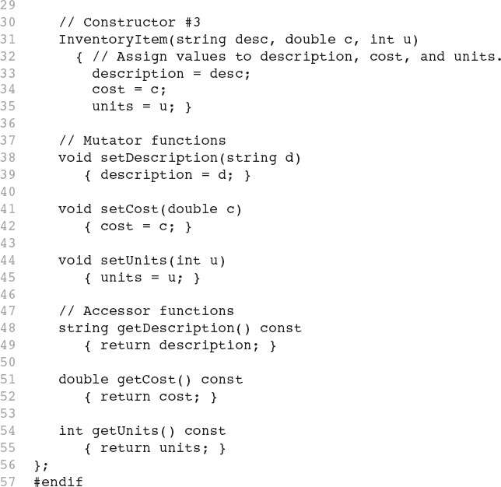

Slide 81
Only One Default Constructor
and One Destructor
Do not provide more than one default constructor for a class: one that takes no arguments and one that has default arguments for all parameters
Square();
Square(int = 0); // will not compile
Since a destructor takes no arguments, there can only be one destructor for a class

Slide 82
Member Function Overloading
Non-constructor member functions can also be overloaded:
void setCost(double); void setCost(char *);
Must have unique parameter lists as for constructors

Slide 83
3.11
Using Private Member Functions

Slide 84
Using Private Member Functions
A private member function can only be called by another member function
It is used for internal processing by the class, not for use outside of the class
See the createDescription function in ContactInfo.h (Version 2)

Slide 85
13.12
Arrays of Objects

Slide 86
Arrays of Objects
Objects can be the elements of an array:
InventoryItem inventory[40];
Default constructor for object is used when array is defined

Slide 87
Arrays of Objects
Must use initializer list to invoke constructor that takes arguments:
InventoryItem inventory[3] =
{ "Hammer", "Wrench", "Pliers" };

Slide 88
Arrays of Objects
If the constructor requires more than one argument, the initializer must take the form of a function call:

Slide 89
Arrays of Objects
It isn't necessary to call the same constructor for each object in an array:

Slide 90
Accessing Objects in an Array
Objects in an array are referenced using subscripts
Member functions are referenced using dot notation:
inventory[2].setUnits(30);
cout << inventory[2].getUnits();

Slide 91
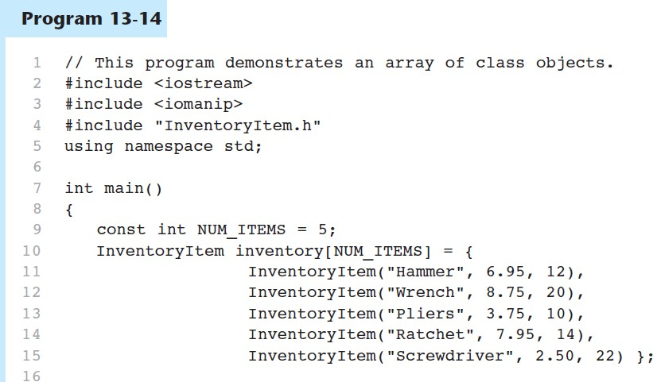

Slide 92
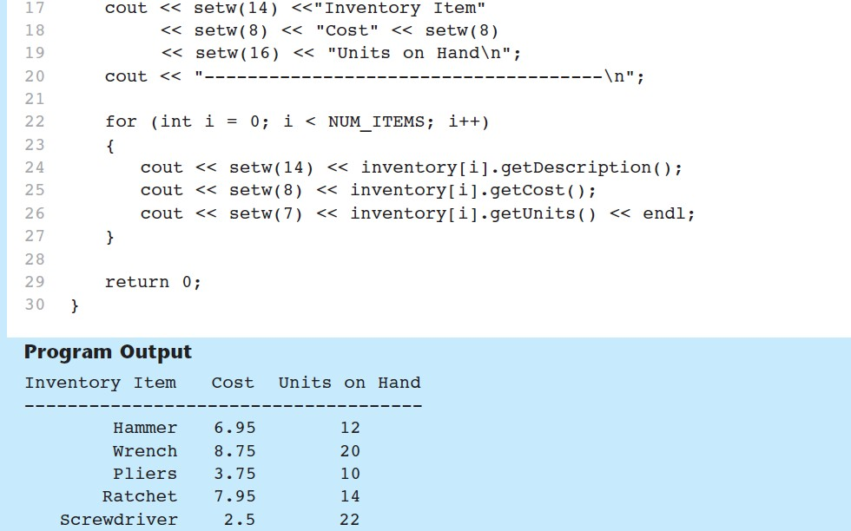
Program 13-14 (Continued)

Slide 93
13.16
The Unified Modeling Language

Slide 94
The Unified Modeling Language
UML stands for Unified Modeling Language.
The UML provides a set of standard diagrams for graphically depicting object- oriented systems

Slide 95
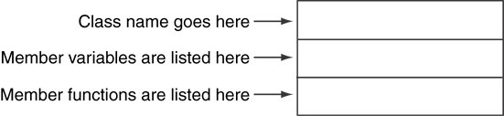
UML Class Diagram
A UML diagram for a class has three main sections.

Slide 96
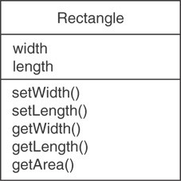
Example: A Rectangle Class
class Rectangle
{
private:
double width; double length;
public:
bool setWidth(double);
bool setLength(double); double getWidth() const; double getLength() const; double getArea() const;
};

Slide 97
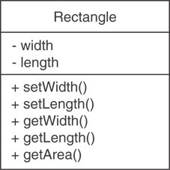
UML Access Specification Notation
In UML you indicate a private member with a minus (-) and a public member with a plus(+).
These member variables are
private.
These member functions are
public.

Slide 98
UML Data Type Notation
To indicate the data type of a member variable, place a colon followed by the name of the data type after the name of the variable.
width
length
: double
: double

Slide 99
UML Parameter Type Notation
To indicate the data type of a function’s parameter variable, place a colon followed by the name of the data type after the name of the variable.
+ setWidth(w : double)

Slide 100
UML Function Return Type Notation
To indicate the data type of a function’s return value, place a colon followed by the name of the data type after the function’s parameter list.
+ setWidth(w : double) : void

Slide 101
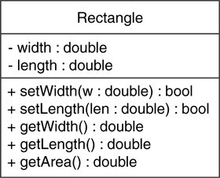
The Rectangle Class

Slide 102
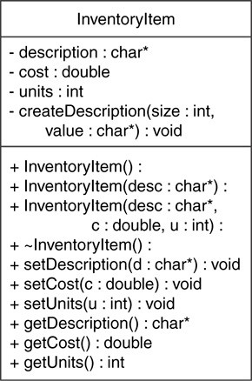
Showing Constructors and Destructors
No return type listed for constructors or destructors
Constructors
Destructor

